Slide 1
R and Baseball
Graham Goldbeck
BARUG October Meeting, 10/9/2012

Slide 2
Acknowledgements
Dave Allen, Baseball Analysts
The idea of using R to make heat maps
Brian Mills, Prince of Slides
The idea of using filled.contour to visualize the map

Slide 3
Sportvision’s PITCHf/x Data
3 camera system, 2 tracking cameras
Installed in all 30 MLB Parks
Also in 33 MiLB Parks, Korea, Dominican Republic
Tracked 99.8% of pitches since 2008
Gets 9p trajectory of each pitch
Initial Location, Velocity, and Acceleration in 3 dimensions
Also tracks HITf/x 6p trajectory batted ball data
Initial Location and Velocity of the batted ball in 3 dimensions

Slide 4
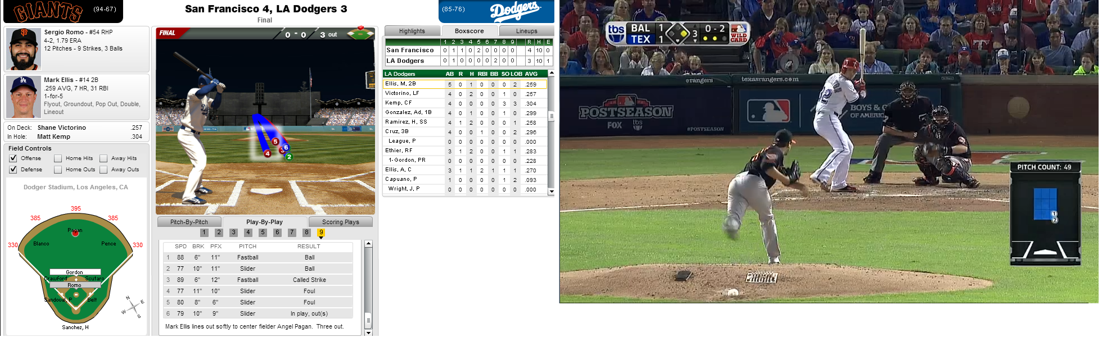
Examples of PITCHf/x in the Media

Slide 5
R Code
fit <- loess(initial_speed ~ cross_plate_x + cross_plate_z, span=c(.4), degree=1)
myx <- matrix(data=seq(from=-2, to=2, length=24), nrow=24, ncol=24)
myz <- t(matrix(data=seq(from=0, to=5, length=24), nrow=24, ncol=24))
fitdata <- data.frame(cross_plate_x=as.vector(myx), cross_plate_z=as.vector(myz))
mypredict <- predict(fit, fitdata)
mypredict[is.na(mypredict)] <- 0
mypredict <- matrix(mypredict,nrow=c(24,24))
filled.contour(
x=seq(from=-2, to=2, length=24),
y=seq(from=0, to=5, length=24),
z=mypredict,
bg=par('bg'),
main="Posey Heat Map",
nlevels=200,
color=colorRampPalette( c('green', 'greenyellow', 'yellow', 'gold', 'orange', 'darkorange',
'red', 'red', 'red', 'red', 'red', 'red', 'red')),
plot.axes={ axis(1)
axis(2)
rect(-0.708335, 1.75, 0.708335, 3.5, border="black", lty="dashed", lwd=2)
}
)

Slide 6
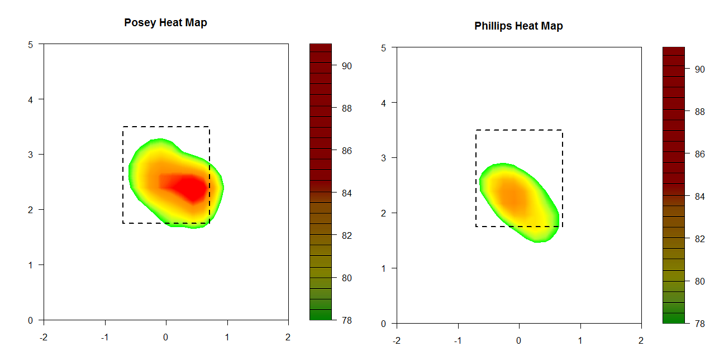
Resulting Images

Slide 7
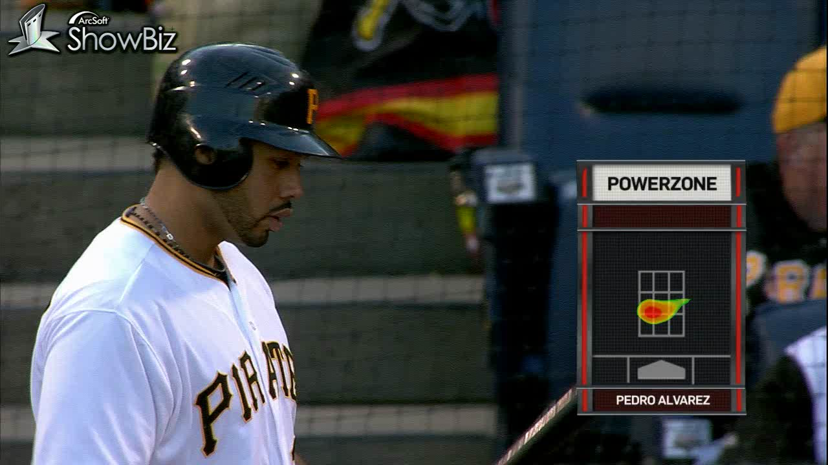
Broadcast Clip

Slide 8

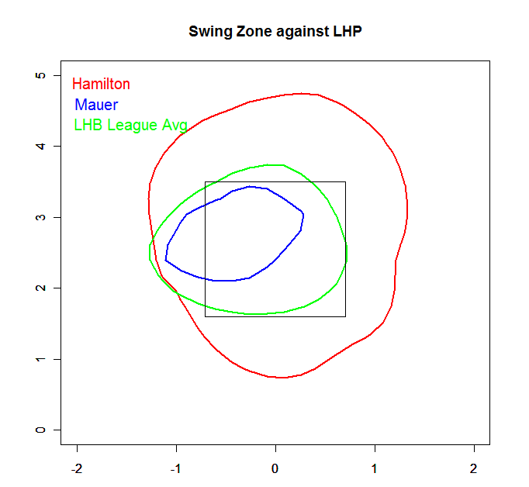
Other Uses for PITCHf/x data and R
Hitter Evaluation
Pitcher Scouting

